Slide 1
Secure Data Hiding In Images Using Steganography
CAPSTONE PROJECT
Presented By: Kaustubh Suresh Patil
Student Name: Kaustubh Suresh Patil
College Name & Department : Pimpri Chinchwad College of Engineering And Reseach, Pune &
Computer Engineering

Slide 2
OUTLINE
Problem Statement
Technology used
Wow factor
End users
Result
Conclusion
Git-hub Link
Future scope

Slide 3
Problem Statement
Traditional encryption methods are easily detectable, raising suspicion and compromising secure communication. To address this, steganography offers a discreet solution by hiding confidential messages within images without altering their visual integrity. This project develops a steganography tool using Least Significant Bit (LSB) techniques to embed and extract messages securely. It ensures data protection against unauthorized access and steganalysis while maintaining image quality. Additionally, a user-friendly GUI built with tkinter makes the tool accessible to non-technical users. By combining advanced steganography with an intuitive interface, this project enables secure, undetectable communication for all users.

Slide 4
Technology used
Image Processing Libraries: Python with libraries such as Pillow for manipulating and processing image files. NumPy for handling pixel data and performing mathematical operations efficiently.
Graphical User Interface (GUI): Tkinter to build an intuitive, user-friendly interface for encoding and decoding messages, making the tool accessible to non-technical users.
File Handling: Support for standard image formats such as PNG, JPEG, and BMP, ensuring compatibility with a wide range of image types.
Data Security: Robust protection mechanisms to safeguard against steganalysis attacks and unauthorized extraction, ensuring that hidden data remains undetectable and secure.

Slide 5
Wow factors
Seamless Integration: Hide confidential messages within images without any visible distortion, ensuring the cover image looks untouched.
User-Friendly Interface: A sleek and intuitive GUI built with Tkinter makes encoding and decoding messages effortless, even for non-technical users.
Cross-Platform Compatibility: Works flawlessly on Windows, macOS, and Linux, providing a consistent experience across all platforms.
Advanced Security: Protects hidden messages against steganalysis attacks, ensuring your data remains undetectable and secure.
High Compatibility: Supports popular image formats like PNG, JPEG, and BMP, making it versatile for various use cases.
Real-Time Feedback: A status bar provides instant updates during encoding and decoding, enhancing user experience.
Customizable Delimiters: Configurable end-of-message delimiters for added flexibility and security.

Slide 6
End users
Corporate Security Teams: Organizations seeking to securely transmit sensitive information, such as confidential documents, over unsecured communication channels while preventing unauthorized access.
Government Agencies: Security-conscious departments that require secure communication of classified data without the risk of detection, such as intelligence agencies.
Journalists and Activists: Individuals working in high-risk environments who need to protect sensitive information, communications, or whistleblower data, ensuring it remains hidden and safe from government or corporate surveillance.
Private Individuals: Users interested in protecting personal data, such as passwords or confidential communications, who may wish to use everyday images for hidden data transmission without alerting potential eavesdroppers.
Developers and Security Professionals: Technical users who wish to integrate steganography solutions into their applications or systems, ensuring that confidential information can be safely embedded into images for secure data exchange.
Cryptography Enthusiasts and Researchers: Individuals exploring advanced encryption, steganography techniques, or researching vulnerabilities and innovations in data security.
Educational Institutions: Schools or universities that want to teach or demonstrate secure communication practices through the use of steganography in their cybersecurity curriculum.

Slide 7
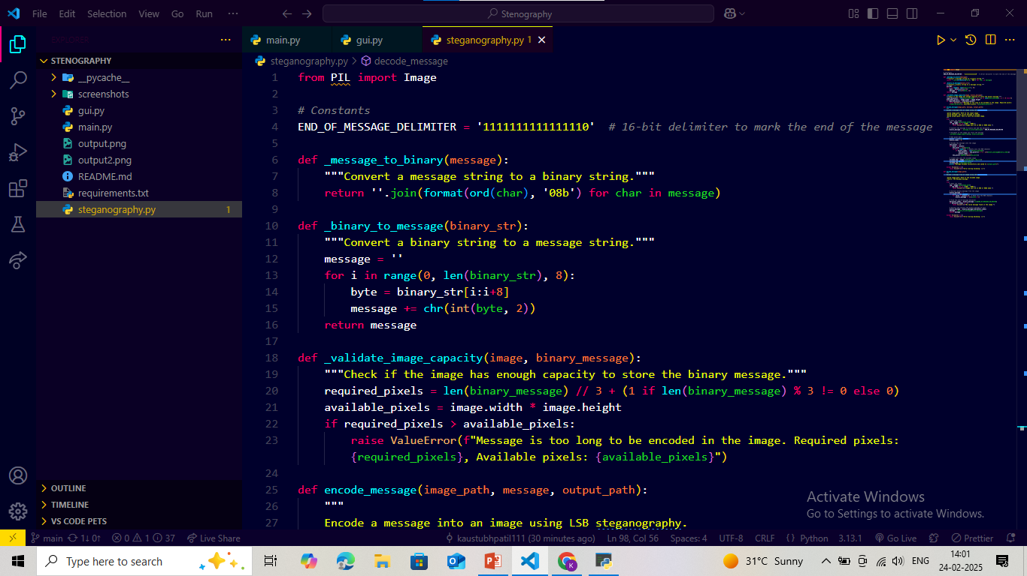
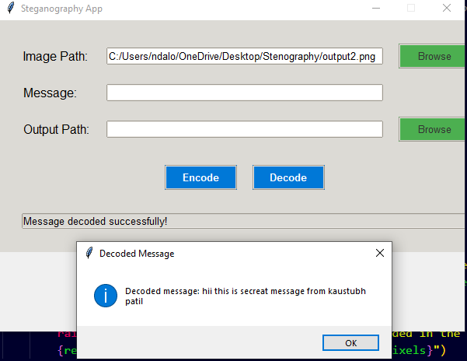
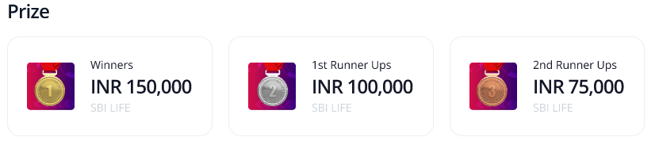

Results
Encryption Code: GUI:
Input Image File:
Output Image File:

Slide 8
Conclusion
In conclusion, the Secure Data Hiding in Images Using Steganography project successfully addresses the limitations of traditional encryption methods by providing a discreet and highly secure way to hide confidential messages within images. By leveraging steganography, this system ensures that the embedded data remains invisible and undetectable, preserving the integrity and quality of the cover image. The user-friendly interface makes encryption and decryption processes accessible to individuals with little to no technical knowledge, broadening its usability. This solution ensures robust data security, protecting sensitive information from unauthorized access, while offering a practical, efficient, and accessible approach to secure communication.

Slide 9
GitHub Link
git@github.com:kaustubhpatil111/Stenography.git

Slide 10
Future scope(optional)
Advanced Steganographic Algorithms: Integrating more sophisticated steganographic techniques like Adaptive Steganography or Machine Learning-based Methods to increase robustness and resistance to steganalysis attacks, making the hidden data even harder to detect.
Support for Multimedia Data: Expanding the project to support video and audio files for embedding hidden data, enabling secure communication through various multimedia channels.
Cloud Integration: Enabling the ability to upload and securely share hidden messages through cloud services, integrating with platforms like AWS or Google Cloud, enhancing scalability and accessibility.
Compression and Encryption Optimization: Further optimizing the compression algorithms and encryption techniques to reduce the size of hidden data while maintaining a high level of security and image quality.
Cross-Platform Support: Developing versions of the tool for mobile devices (Android/iOS) and web applications, making it more accessible and versatile for end-users across multiple platforms.
Real-Time Communication: Creating a real-time communication platform that embeds hidden data in images exchanged over messaging apps, offering seamless and secure messaging for users.
Integration with Blockchain: Utilizing blockchain technology to ensure data integrity and verify the authenticity of messages, providing an additional layer of security to prevent tampering with the hidden data.
Data Analytics and Forensics: Incorporating features for data forensics, allowing users to analyze images for potential hidden messages or ensure the authenticity of received data, while maintaining privacy.

Slide 11
THANK YOU

